Slide 1
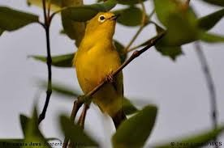
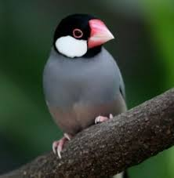
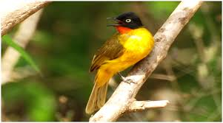
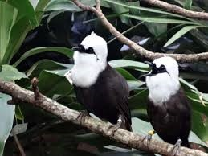
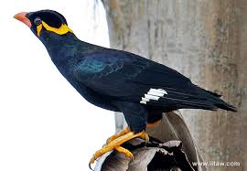
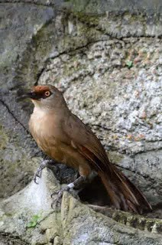
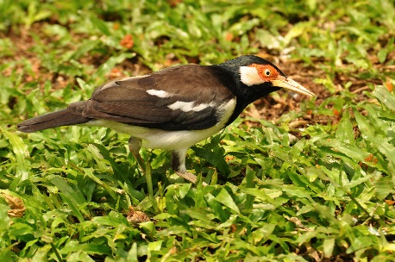
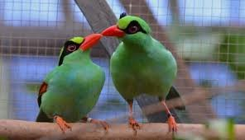
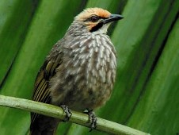
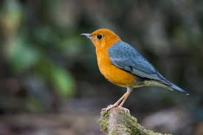
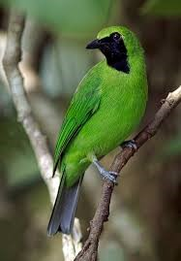
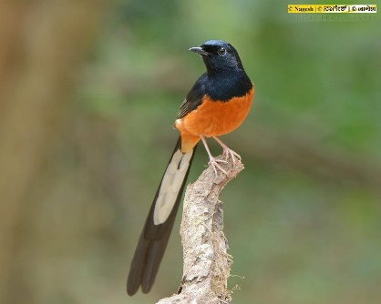
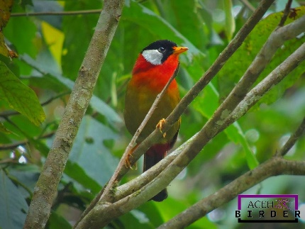
P C B C
P r i g e n C o n s e r v a t i o n B r e e d i n g C e n t e r

Slide 2
The first unit

Slide 3
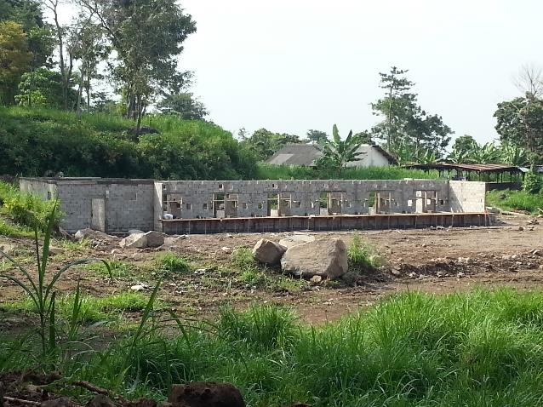
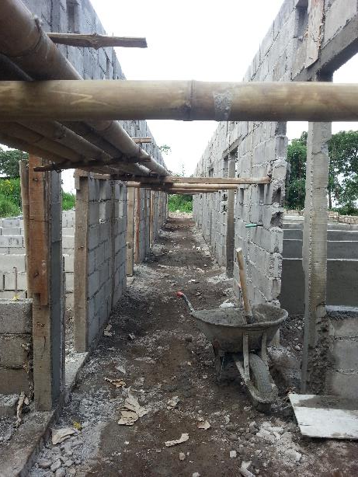
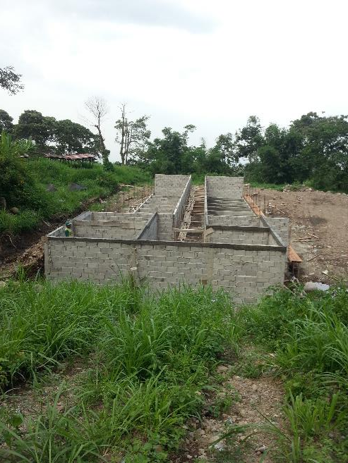
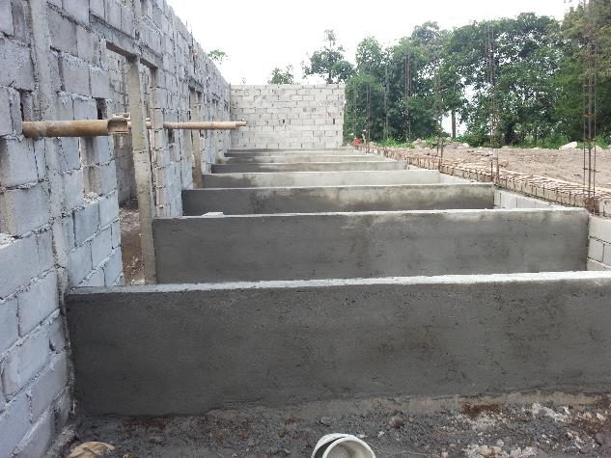

Slide 4
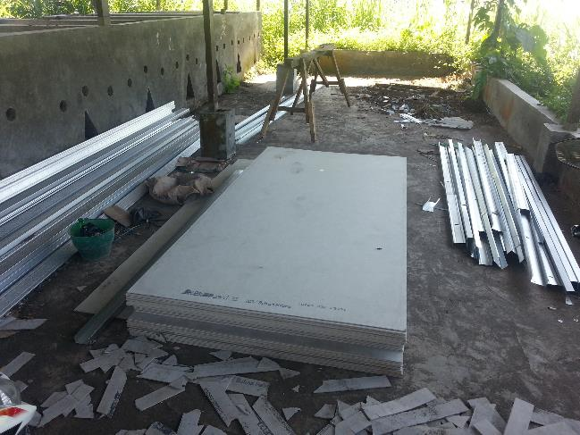
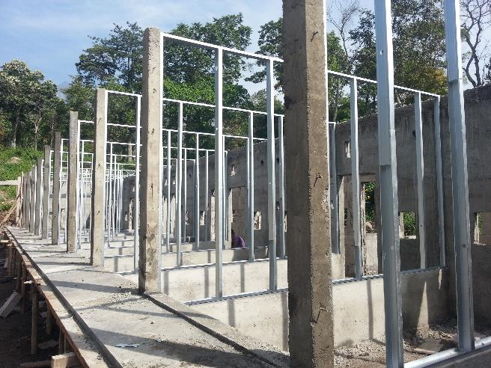
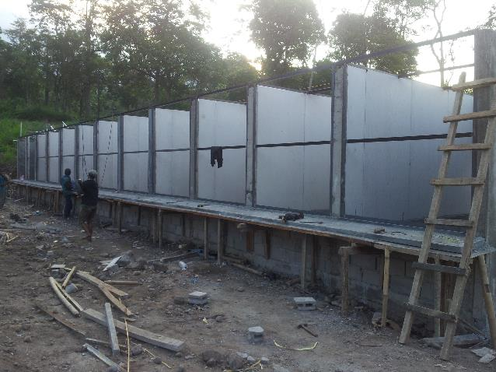
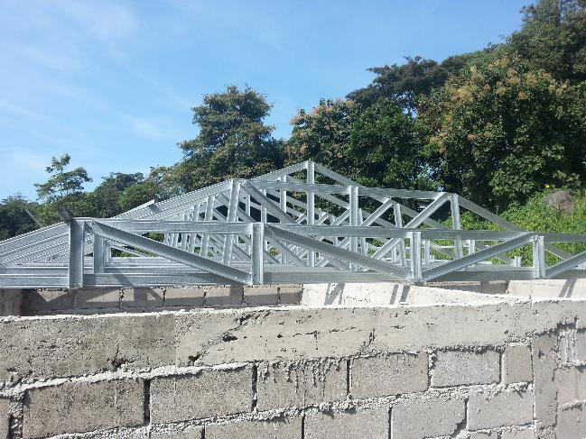

Slide 5
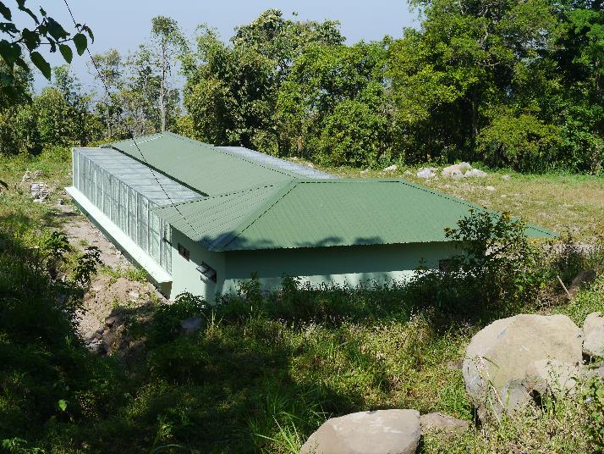
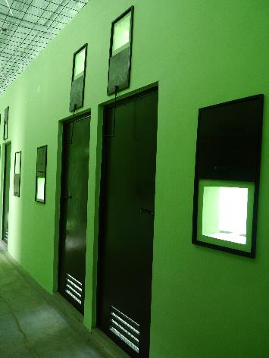
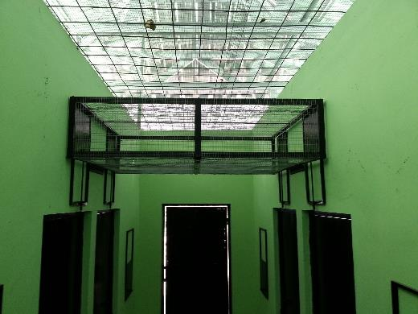
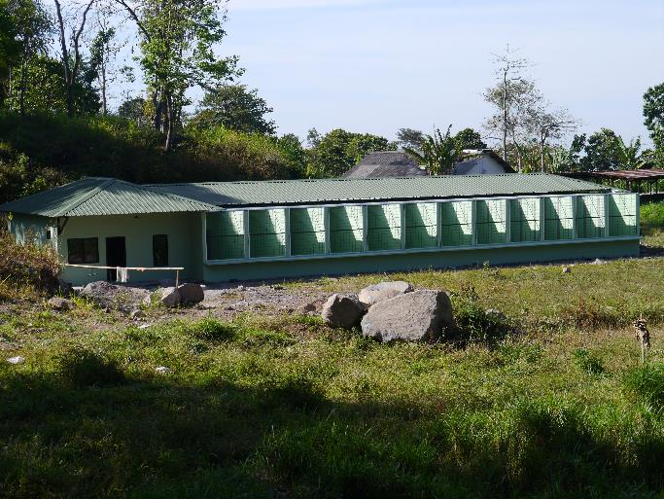
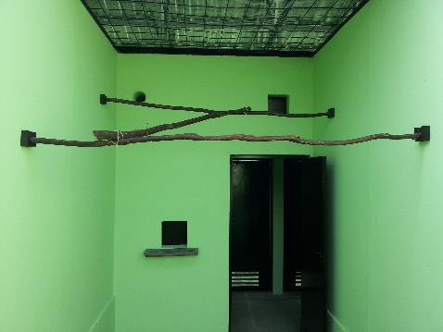
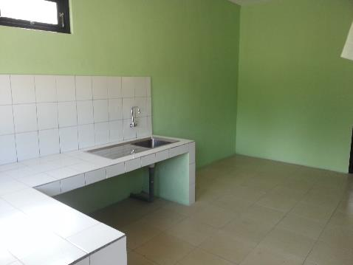

Slide 6
Sponsors and Funding
IDR | €uro
7.500.000 | 500
30.000.000 | 2.000
40.000.000 | 2.666
45.000.000 | 3.000
45.000.000 | 3.000
45.000.000 | 3.000
60.000.000 | 4.000
72.000.000 | 4.800
75.000.000 | 5.000
75.000.000 | 5.000
479.500.000 | 32.966
392.500.500 | 26.176
896.000.000 | 59.133
Zoo Dresden
Zoo Cologne
Shanghai Group (Office)
ZGAP Clip Award (Winner)
Zoo Basel
St. Laurent (Food supplier)
Zoo Leipzig
ZGAP (for Manager Stephan)
Bird park Marlow
Zoo Berlin
Summary from sponsors
KASI Foundation
Total

Slide 8
Outstanding amount for the second phase
Zoo Liberec 30.000.000 IDR
2.000 €
Segre Foundation for second unit 525.000.000 IDR
35.000 €
KASI 20 % for second unit 120.000.000 IDR
8.000 €
costs for the road to the office
costs for the safety fence 1.600.000.000 IDR
107.000 €

Slide 9
The
new
lay
out

Slide 10
To all of you: thanks a lot for your support
S h a n g h a i G r o u p

