Slide 1
About why Southeast Asian songbirds are threatened and how we can help them

Slide 2
Which birds are Southeast Asian songbirds?

Slide 3
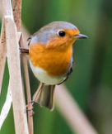
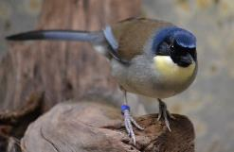
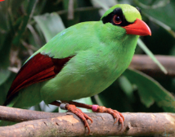
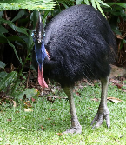
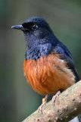
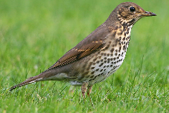
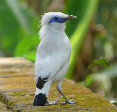
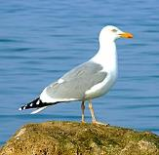
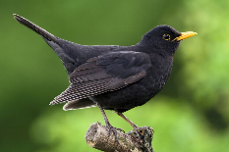
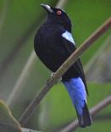
Five of these birds are Southeast-Asian songbirds. Three are European songbirds. Two are no songbirds at all. Can you tell which birds belongs to which group?
robin blue-crowned laughingtrush white-rumped shama javan green magpie cassuary
song thrush Bali starling seagull fairy bluebird blackbird
Notes:
Click to see the names of these birds appear. Solution on next page!

Slide 4
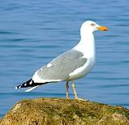
Solution: Southeast-Asian songbirds, European songbirds, not a songbird
robin blue-crowned laughingtrush white-rumped shama javan green magpie cassuary
song thrush Bali starling seagull fairy-bluebird blackbird

Slide 5
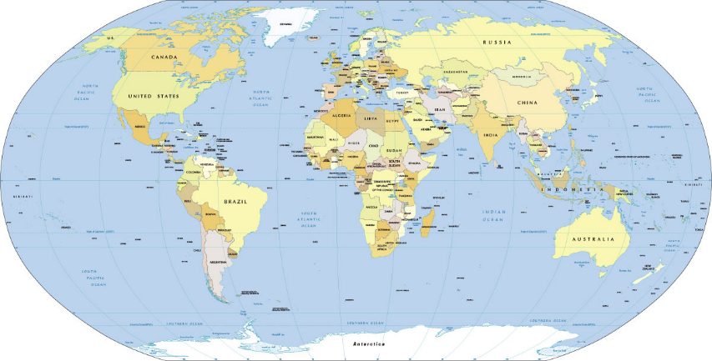
Where is Southeast Asia on this map?
Notes:
Let a child point out your home country, Europe and Southeast Asia. Which countries belong to southeas Asia, who can name one?

Slide 6
What is the problem of Asian Songbirds?

Slide 7
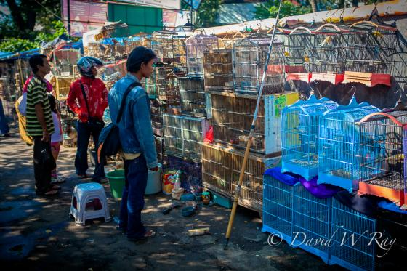
Notes:
Each year, millions of songbirds are caught from the wild to be sold on markets.

Slide 8
Why are all these birds caught?

Slide 9
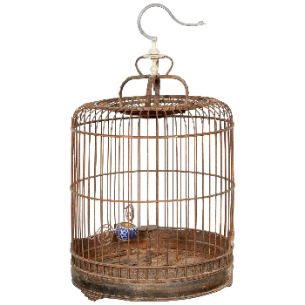
?
Notes:
To be eaten, to be kept as pets, or to sell their beautiful feathers?

Slide 10
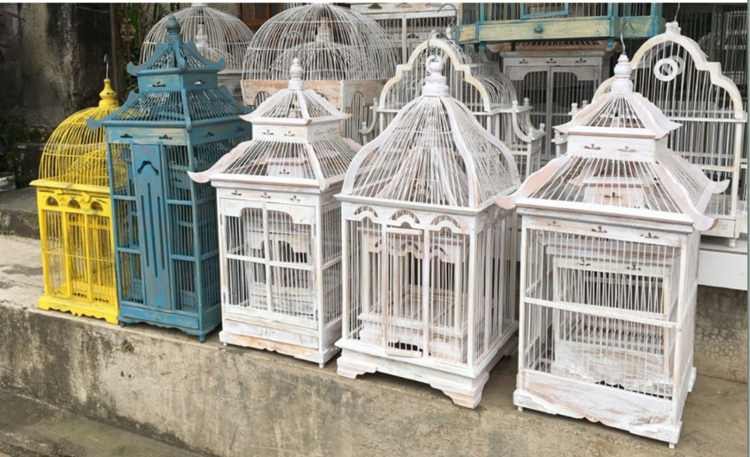
Notes:
They are kept as pets, in cages looking like this.

Slide 11
How would you feel, alone in a tiny cage?

Slide 12
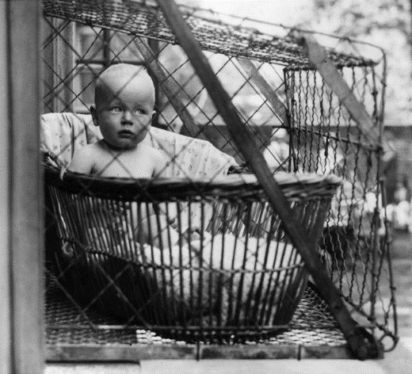
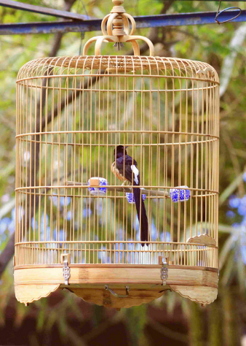
Notes:
Funny enough, pictures like the left one ARE real! In the 1950ies in some European countries parents put their babies in de summer in cages next to their appartment. It was thought, that the fresh air was very healthy… so the pic looks weired, but is real. On the right, a white rumpes shama in a typical cage.

Slide 13
Why do people in Asia keep songbirds as pets?
Notes:
Just because they are good company? Or are there maybe more reasons you can think of?

Slide 14
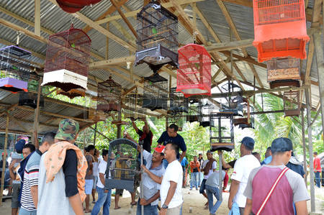
Notes:
Singing contests for birds are very popular in some countries in Southeast Asia. Birds owners get together, bring their birds in cages and a jury votes, which birds sings the most pretty way.

Slide 15
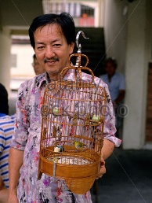
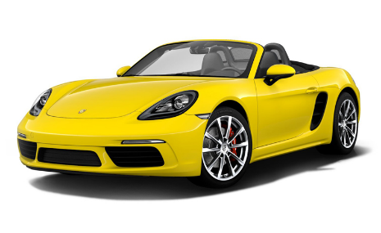
Notes:
The owner of the winning bird get whole a lot of money. A top singing bird is as much worth as a fancy car! People also bet on which bird will win, as amusement and gambling.

Slide 16
Notes:
But many people in the large cities just keep songbirds as pets, because they remind them on a good experience in nature. For example, how they enjoyed singing birds in the rainforest, in the village where they lived during their childhood.

Slide 17
Well, we’ve got pets, too!

Slide 18
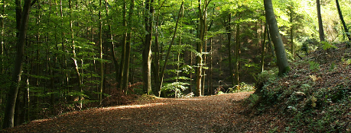
Notes:
Examples for pets are cats, guinea pigs and dogs.
What is the difference between keeping Asian songbirds as pet, and keeping a cat, dog or guinea pig as a pet?
Our pets are real domestic animals. They are bred since many, many years. They are not wild animals that are caught in the forest. Also, we don’t keep them in a tiny cage, alone.

Slide 19
Pets need proper care

Slide 20
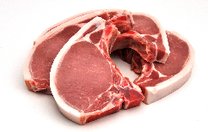
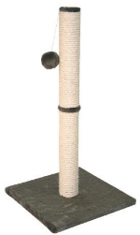
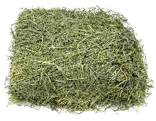
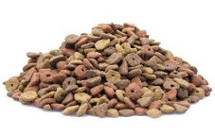
Notes:
Which items is the correct one for which pets? Pets need the correct food, fresh water, cats also need toys to scratch on, guinea pigs need to be able to hide, eg in a box.
Only then, our pets stay happy and healthy.

Slide 21
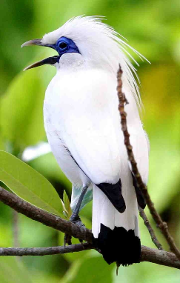
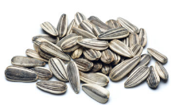
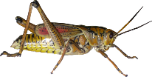
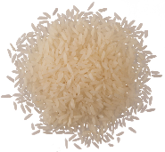
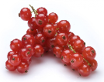
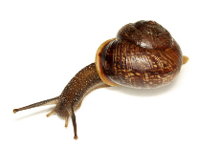
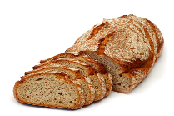
Which food does a Bali Myna need?
Notes:
Maybe, it was easy to match cats and guinea pigs to their right food. But is a lot more difficult, when it comes to exotic birds! What food would a Bali starling need to eat, do you think?
In the wild, they feed on insects, worms, berrys, fruit, seeds and every now and then a lizard.

Slide 22
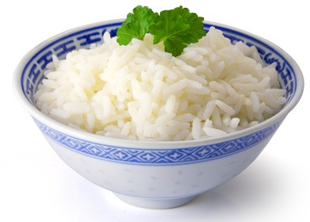
Notes:
If you feed such a bird on rice, like many Asian people do (they eat rice themselves every day), the bird will die.

Slide 23
Unfortunately, many, many songbirds die as pets each year
Notes:
In captivity, as pets, living with pet owners that do not know lot about their proper care, songbirds (esspecially the insect eating species) are very shorelived.

Slide 24
What can we do to help the songbirds in Southeast Asia?

Slide 25
Inform people how to take care for their songbirds better!

Slide 26
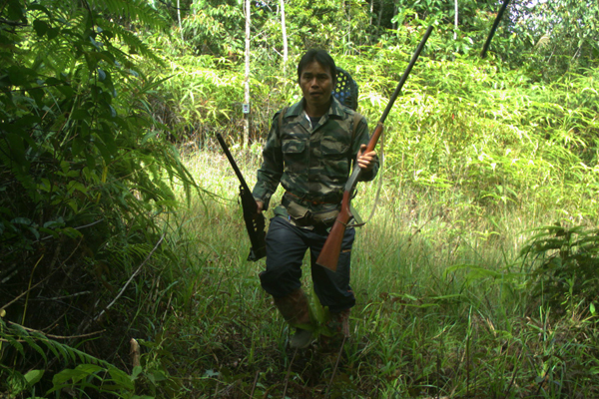
Make national parks and protect-ed areas saver, keep poachers away.

Slide 27
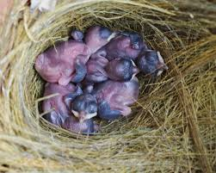
Control if birds traded on the market are bred or come from the forest
Notes:
People must understand that selling so many wild caught birds as pet, is not only a pity for the individual bird… if that many birds are collected, than soon there will be no birds left, and the forests will remain silent.

Slide 28
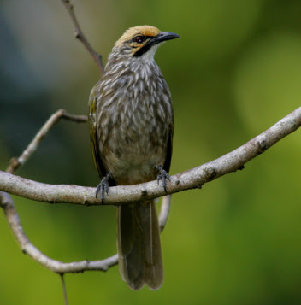
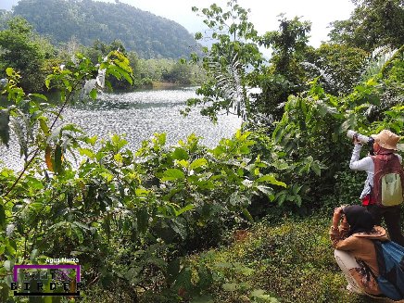
Collect binocculars, help locals enjoy birds in nature
Notes:
Seeing a bird in the wild and listening to its songs, maybe taking pictures is a lot nicer than having a bird in a tiny cage at home!

Slide 29
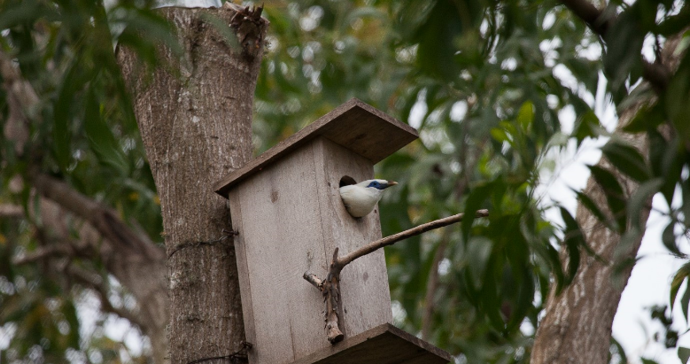
Collect money to support conservation of Asian songbirds
Notes:
Zoos and conservation organisation run and support breeding programmes. Sometimes, it succeeds even to bring birds born in European zoos back to the wild: like the Bali starling in the pictures. These birds were alreay almost extinct. Breeding and releasing them helped to prevent their extintion, but they are still very rare.
The Europeam EAZA zoos participating in the campaign collect money for differend conservation projects to help the Asian songbird.

Slide 30
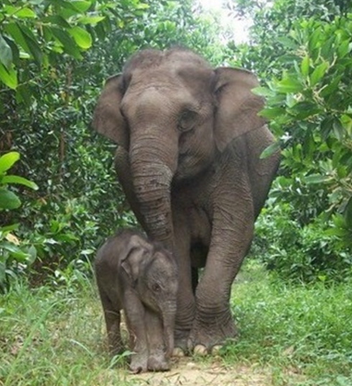
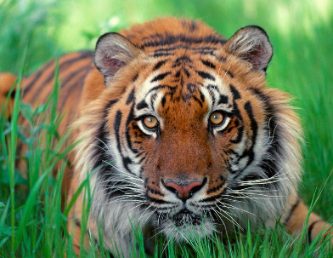
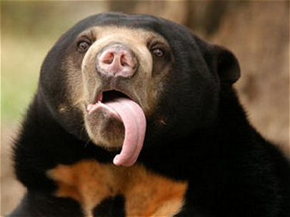
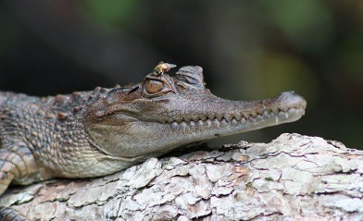
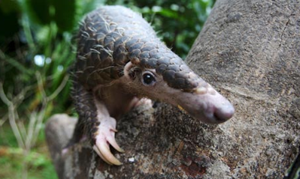
Notes:
Good to know: if we protect the forests which are the homes of songbirds, we also protect the forests where many other animal species live in (eg. sunbear, pangolin)

Slide 31
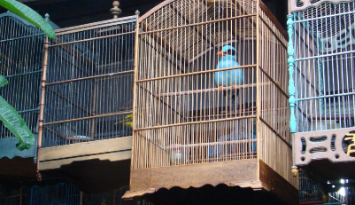
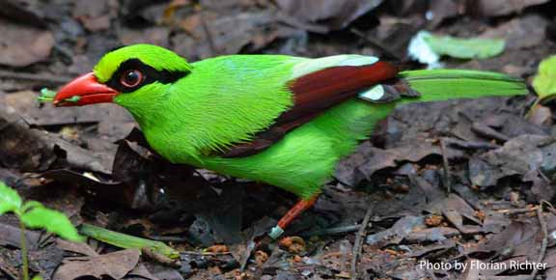
Let’s get into action to help the Southeast-Asian songbirds!
Notes:
Let’s make sure that the Asian songbirds survive in the forest, and that they are not all caught away and end up in tiny cages in bad care (nb. Javan green magpies lose their bright green colour and turn more blueish when not fed the right food).
Can de children also think of ways how to help the songbirds in their garden, here in Europe?

